Slide 1
Water quality
Data science project

Slide 2
Team members department:- Is
Members | Seat Number | Section
رؤى محمد احمد محمد شهاب | 20201700290 | 4
حبيبه محمد مصطفي | 20201700222 | 3
رويدا طاهر منتصر | 20201701194 | 4
احمد رضا البحيري | 20201700040 | 1
يوسف محمد ابراهيم سالم | 20201701028 | 10
عمر نسيم مسعد احمد | 20201700551 | 6

Slide 3
Introduction
Problem Definition:
The problem is to predict water quality based on a set of features related to water composition. The target variable, "is_safe," indicates whether the water is safe for consumption or other uses. The goal is to build a predictive model that can assess water safety based on various chemical and microbial indicators.
Dataset Idea:
The dataset comprises observations of water samples, each associated with 20 features that represent different aspects of water composition. Here's an idea of what some of these features could be:

Slide 4
Dataset description and objective
The dataset is water quality Dataset, containing information about water ingredients and various features like lead, bacteria and silver overall 20 features to predict water quality , data has 7996 row (14168 row after up-balancing).
The objective is to Develop a binary classification model to predict if water safe(1) or not safe(0) based on column target "is_safe" by using a pretrained model and our Deep learning model from scratch.

Slide 5
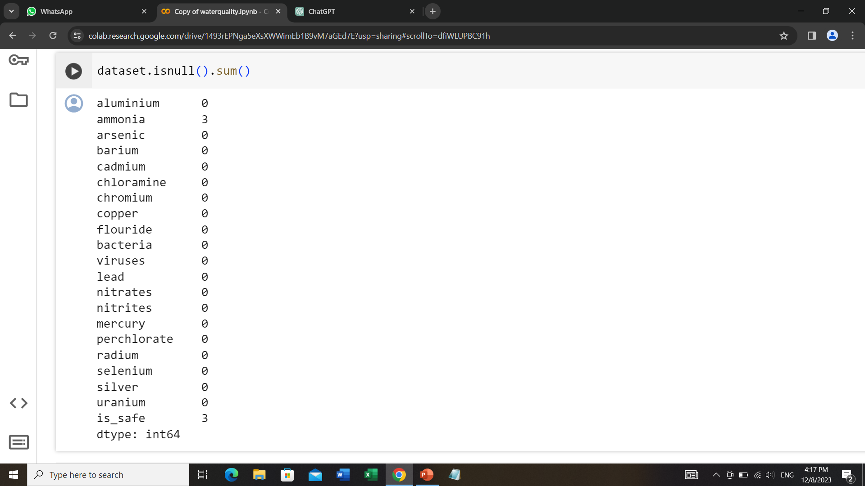
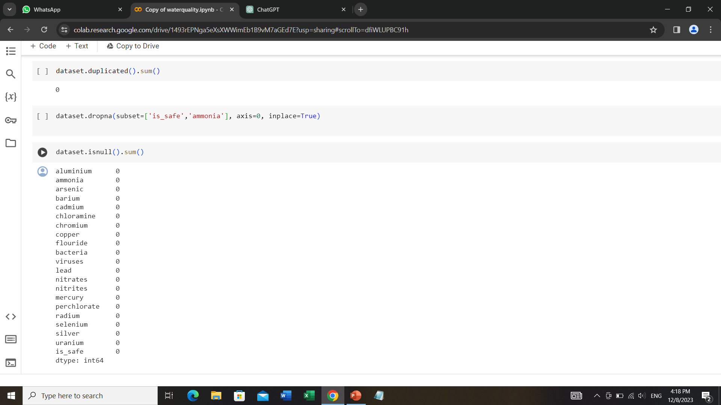
Data preprocessing
1) checking and removing nulls

Slide 6
2)Checking for duplications(no duplications found)

Slide 7
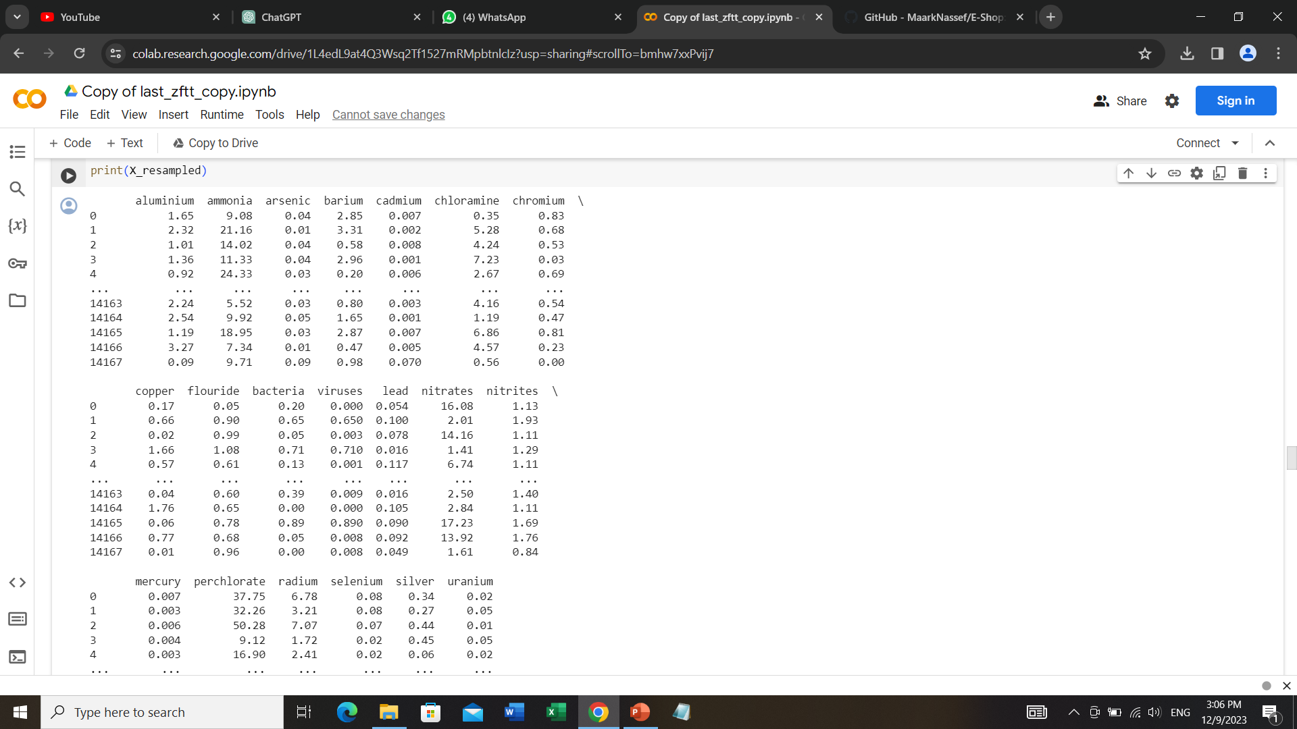
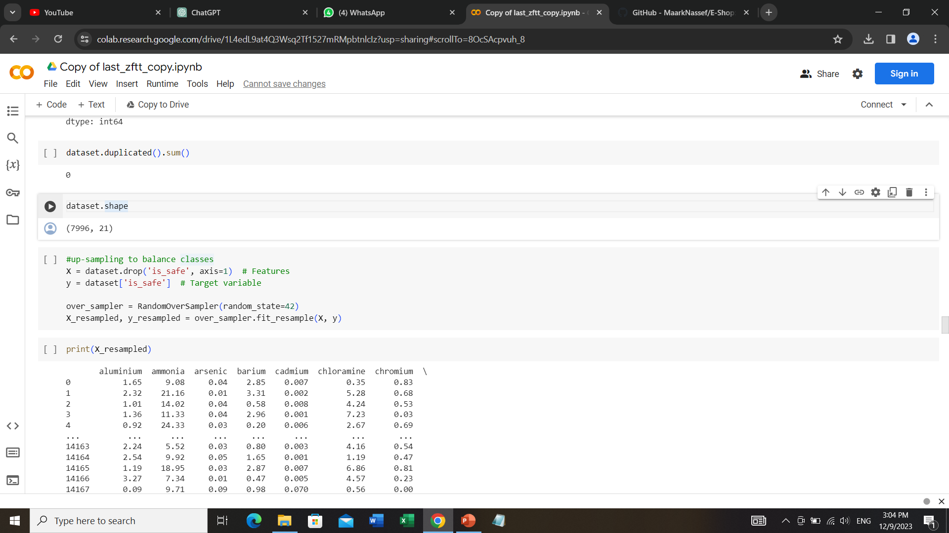

3) Up-sampling to balance classes : needed as number of samples in one of the classes was much bigger than the other one ,so we increased the data size

Slide 8
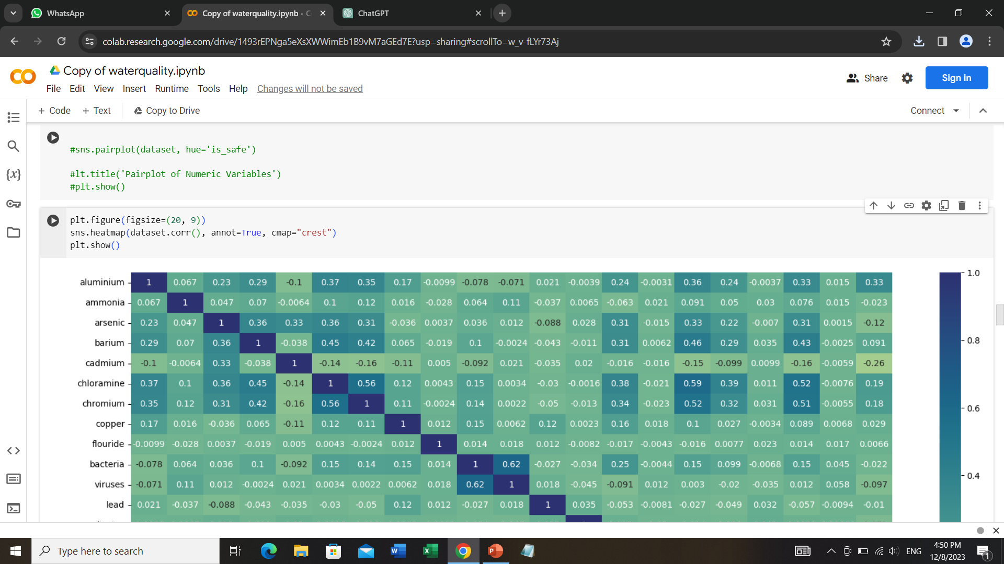
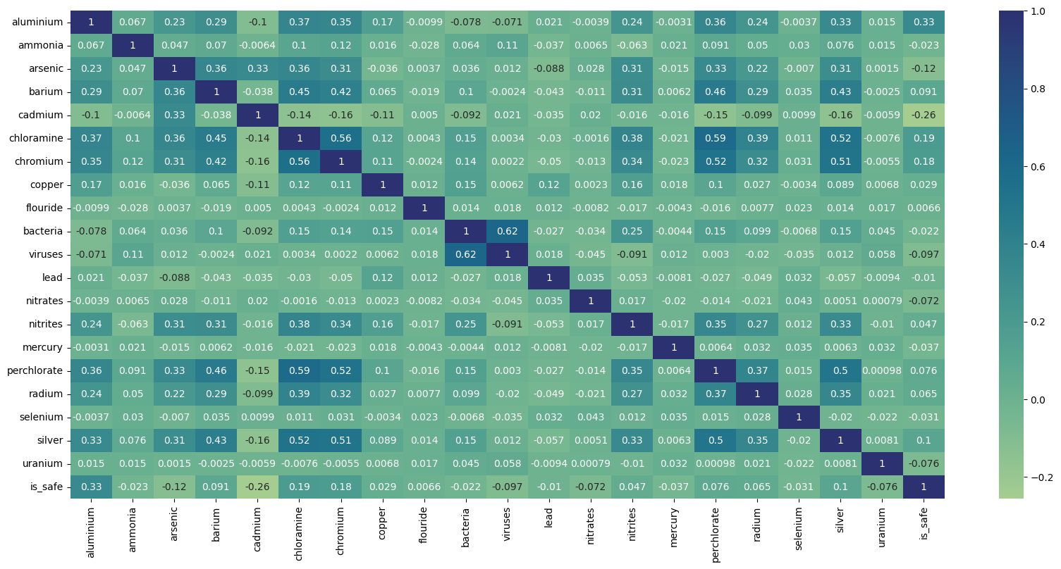
Data Visualization
1) Heatmap

Slide 9
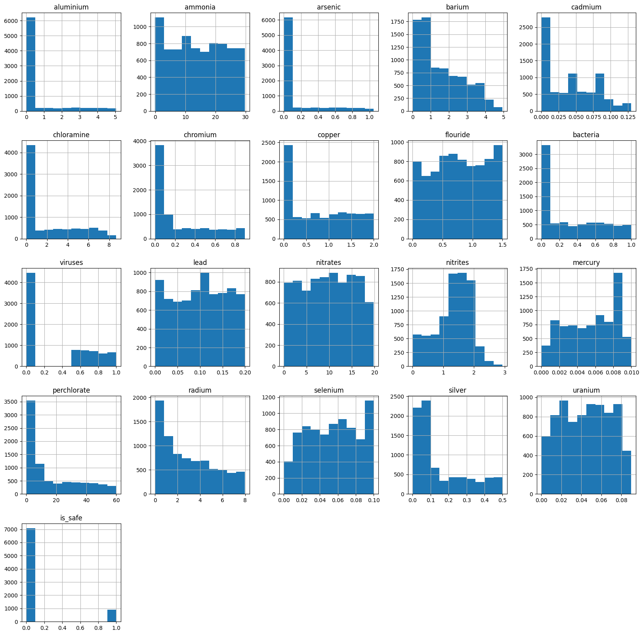
2) Histogram

Slide 10
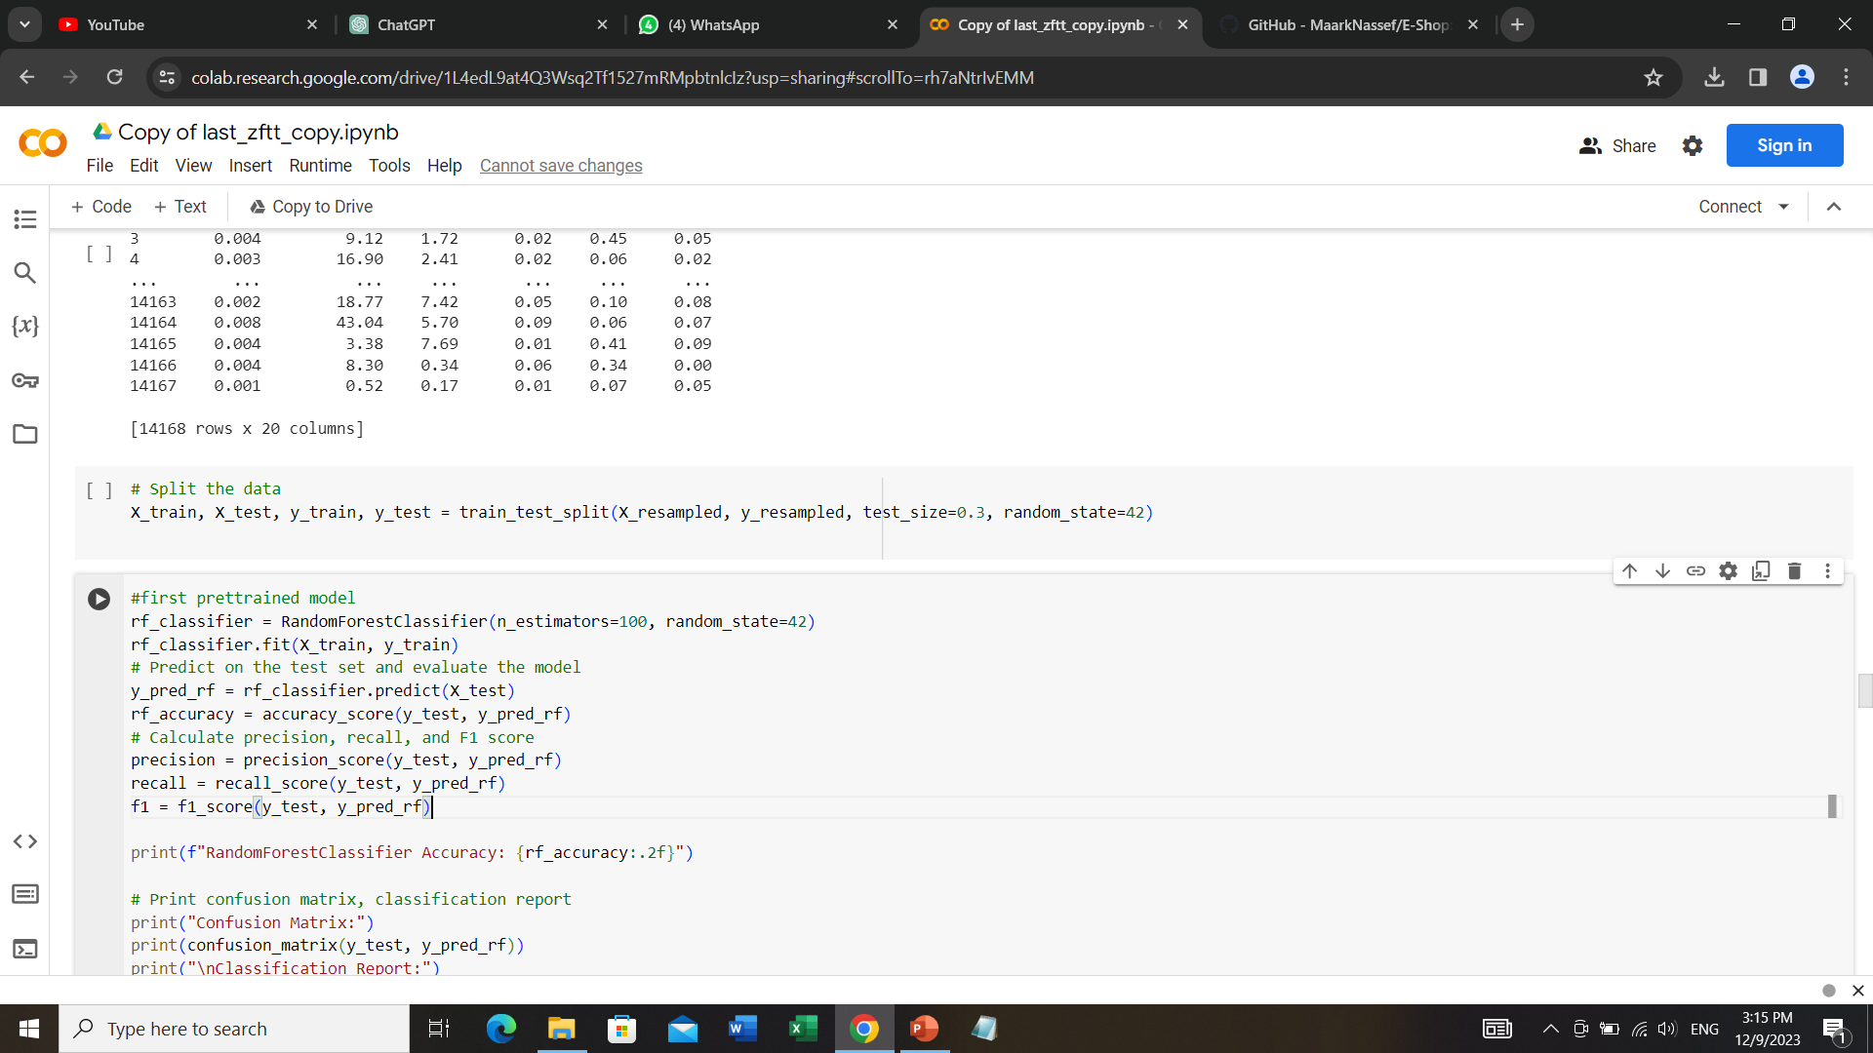
Splitting the data

Slide 11
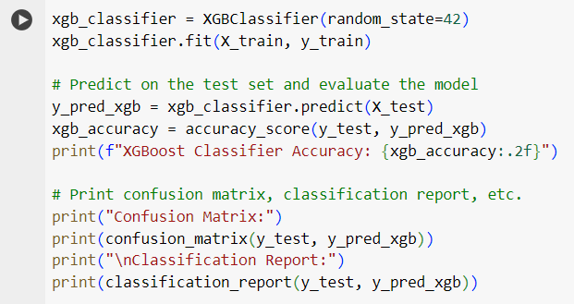
Models
Extreme Gradient Boosting (XGBoost) : for tabular data and aiming for high predictive performance and it provides an efficient and scalable implementation of gradient boosting.

Slide 12

Support Vector Machine (SVM) Model : SVMs can handle non-linear relationships effectively, thanks to the use of kernel functions. If the relationship between water quality and the features is complex and non-linear, SVMs with an appropriate kernel (e.g., radial basis function, RBF) can capture these patterns.

Slide 13

Random Forest Classifier : This ensemble approach often leads to more robust and accurate predictions compared to individual models, especially when dealing with complex relationships in the data.

Slide 14
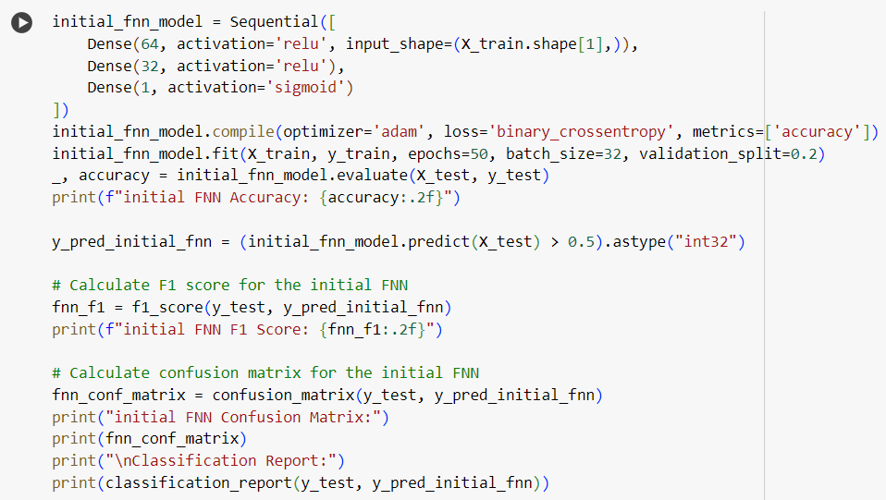
Feedforward Neural Network (FNN) Model : FNNs can automatically learn hierarchical representations and features from the data. This is particularly useful when dealing with high-dimensional datasets like this , where the relationships between features may be subtle and multi-layered.

Slide 15
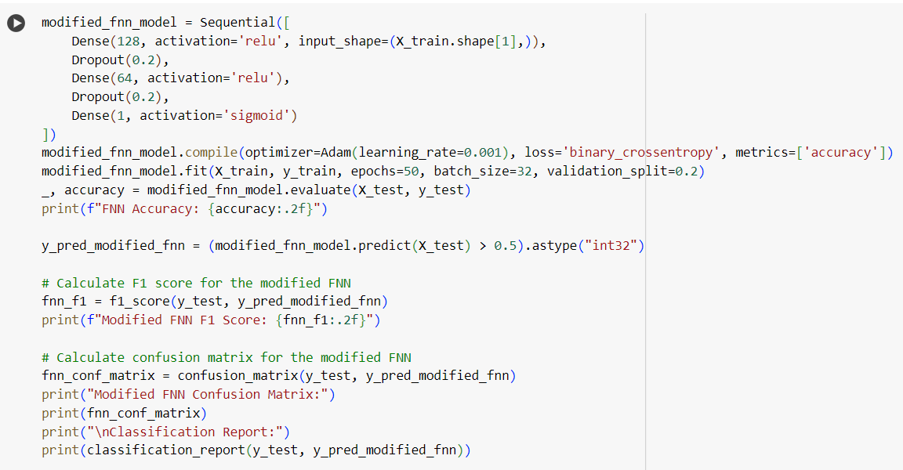
Modified Feedforward Neural Network (FNN) Model : The modified FNN with dropout layers is used to address potential overfitting issues. If the dataset is not large or if the neural network is prone to memorizing noise in the training data, the addition of dropout layers can act as a regularization technique, preventing the network from becoming too reliant on specific features.

Slide 16

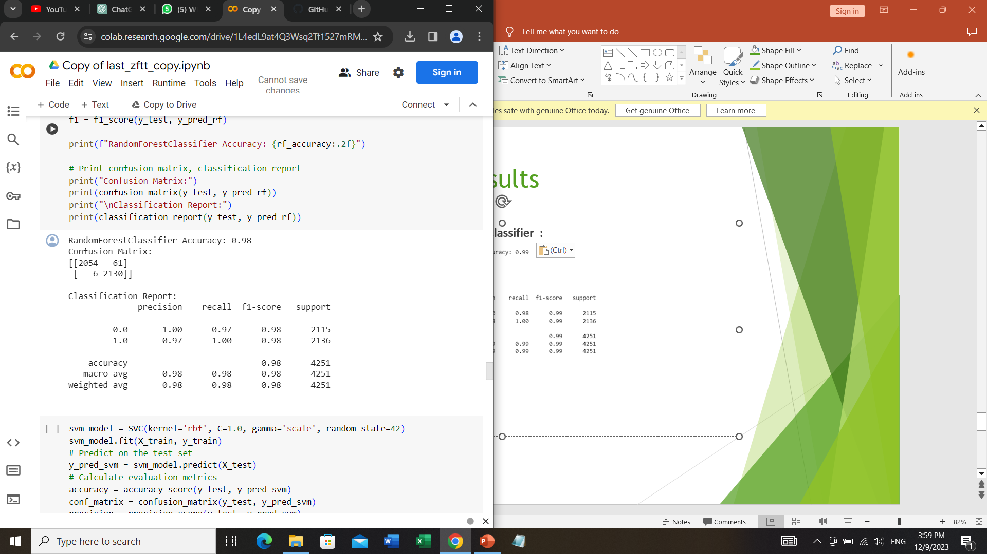
Results
Extreme Gradient Boosting (XGBoost) Classifier :
Random Forest Classifier :

Slide 17
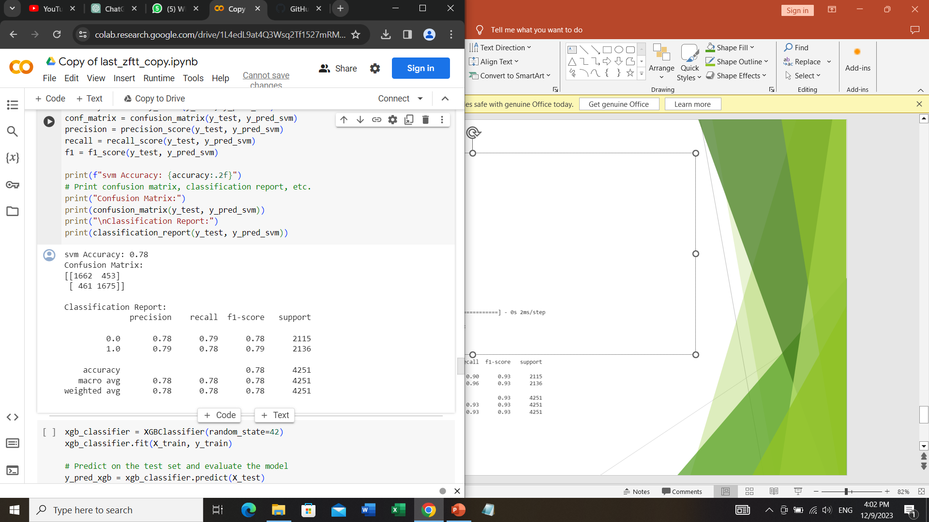
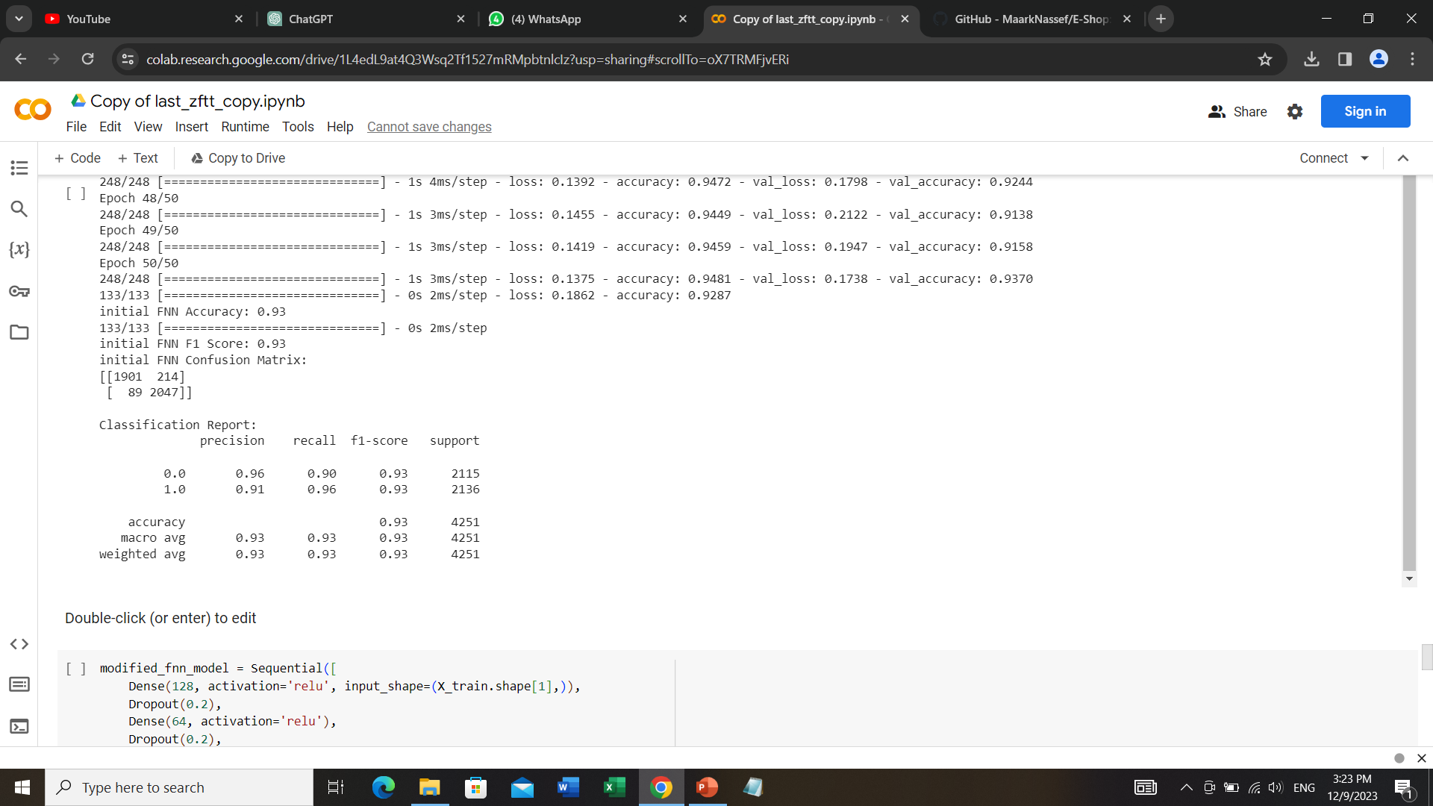
(SVM) model :
(FNN) Model

Slide 18
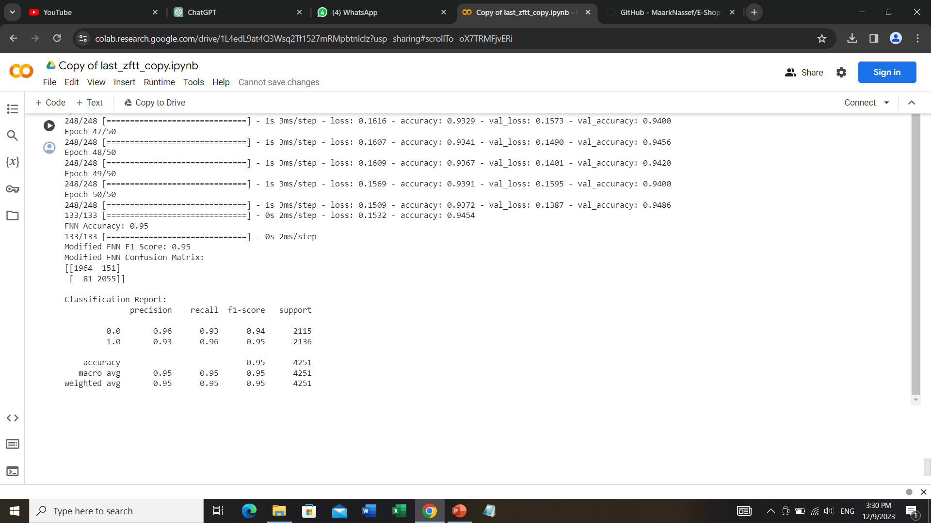
Modified (FNN) Model :

Slide 19
Conclusion
In pretrained models : (XGBoost) Classifier has the highest accuracy with 0.99
In neural networks : the modified (FNN) has the highest accuracy with 0.95

